Slide 1
Using Technology to Address Foundational Reading Skills from Common Core Standards for Students with Autism and other disabilities: An Overview
Ritamarie Theiler, NBCT, M.A. theiler@aps.edu
Heather DiLuzio, M.A. diluzio@aps.edu
Albuquerque Public Schools

Slide 2
Rationale
Foundational skills are an integral part of the Common Core State Standards (CCSS) from K-5
Essential skills for students to become proficient readers
For some students with disabilities importance should be placed on identifying key foundational skills which allow the child to become a functional reader
Instruction needs incorporate tools that allow students to demonstrate knowledge and access instruction in meaningful and engaging ways

Slide 3
Reading Standards: Foundational Skills
Print Concepts (K-1)
Phonological Awareness (K-1)
Phonics and Word Recognition (K-5)
Fluency (K-5)

Slide 4
How do we define technology in the educational setting?
Technology in the educational setting could be defined as the practice of facilitating student learning and improving student performance by creating, using, and/or managing appropriate technological processes and resources. (ocw.metu.edu)

Slide 5
What is already in your room?
Computer
Core Curriculum
Manipulatives
Books
Projector
Promethean Board
iPad
iPod
AAC Devices

Slide 6
Modifications

Slide 7
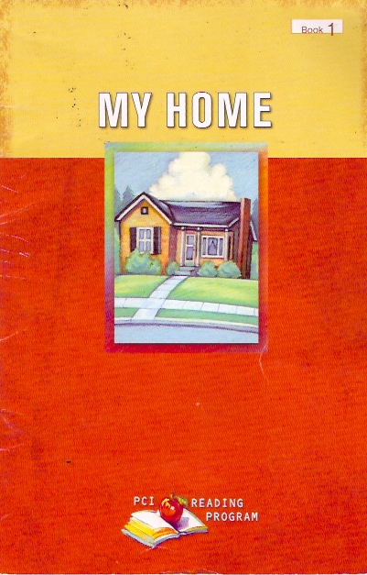
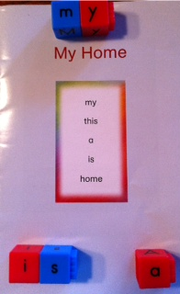
Manipulatives

Slide 8
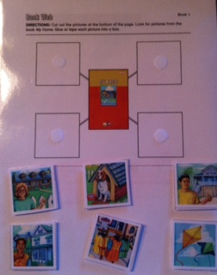
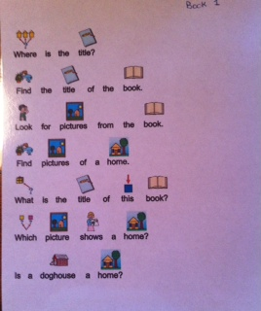
Lamination and Velcro
Notes:
PCI: Level 1, Book 1
Questions written with PicWriter
Velcro and Lamination on Comprehension pages to allow students to re-use until they achieve mastery of concept being introduced

Slide 9
Power Point Book

Slide 10
Flipchart

Slide 11
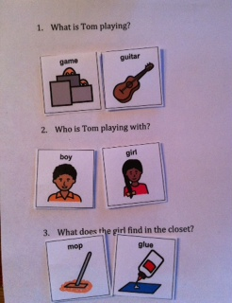
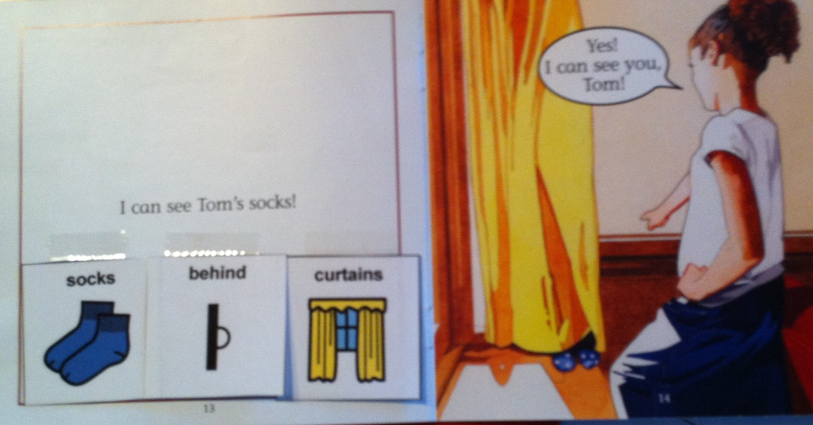
Other Examples
Notes:
Can I See Tom Book (Flyleaf Curriculum)
Discuss how this hits all Foundational Skills
Print Concepts
Phonics and Word Recognition
Fluency

Slide 12
Notes:
Modified Book:
Addresses Print Concepts and Fluency

Slide 13
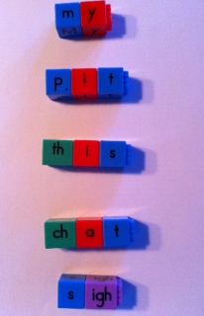

Slide 14
Technology in Action

Slide 15
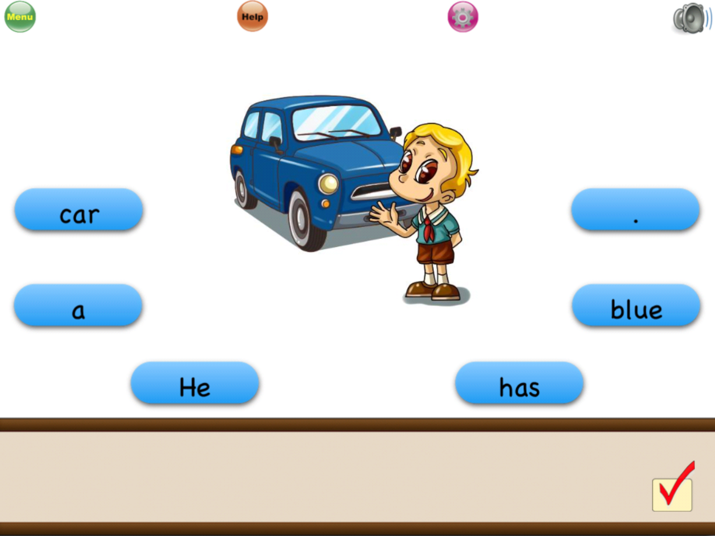
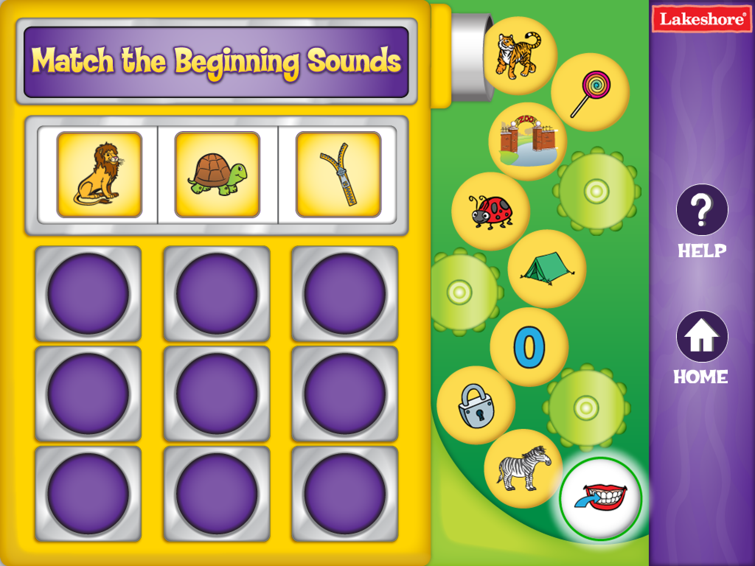
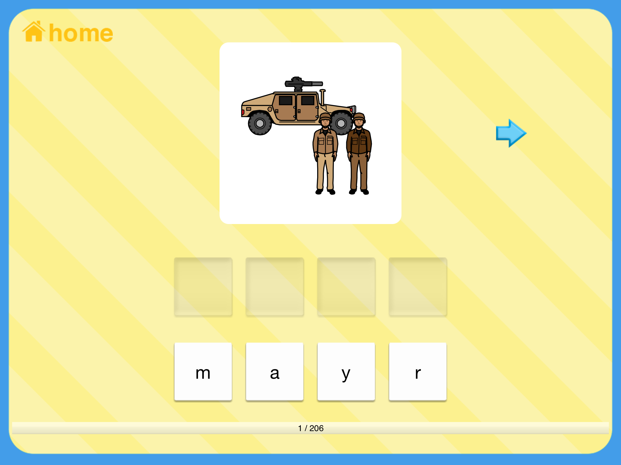
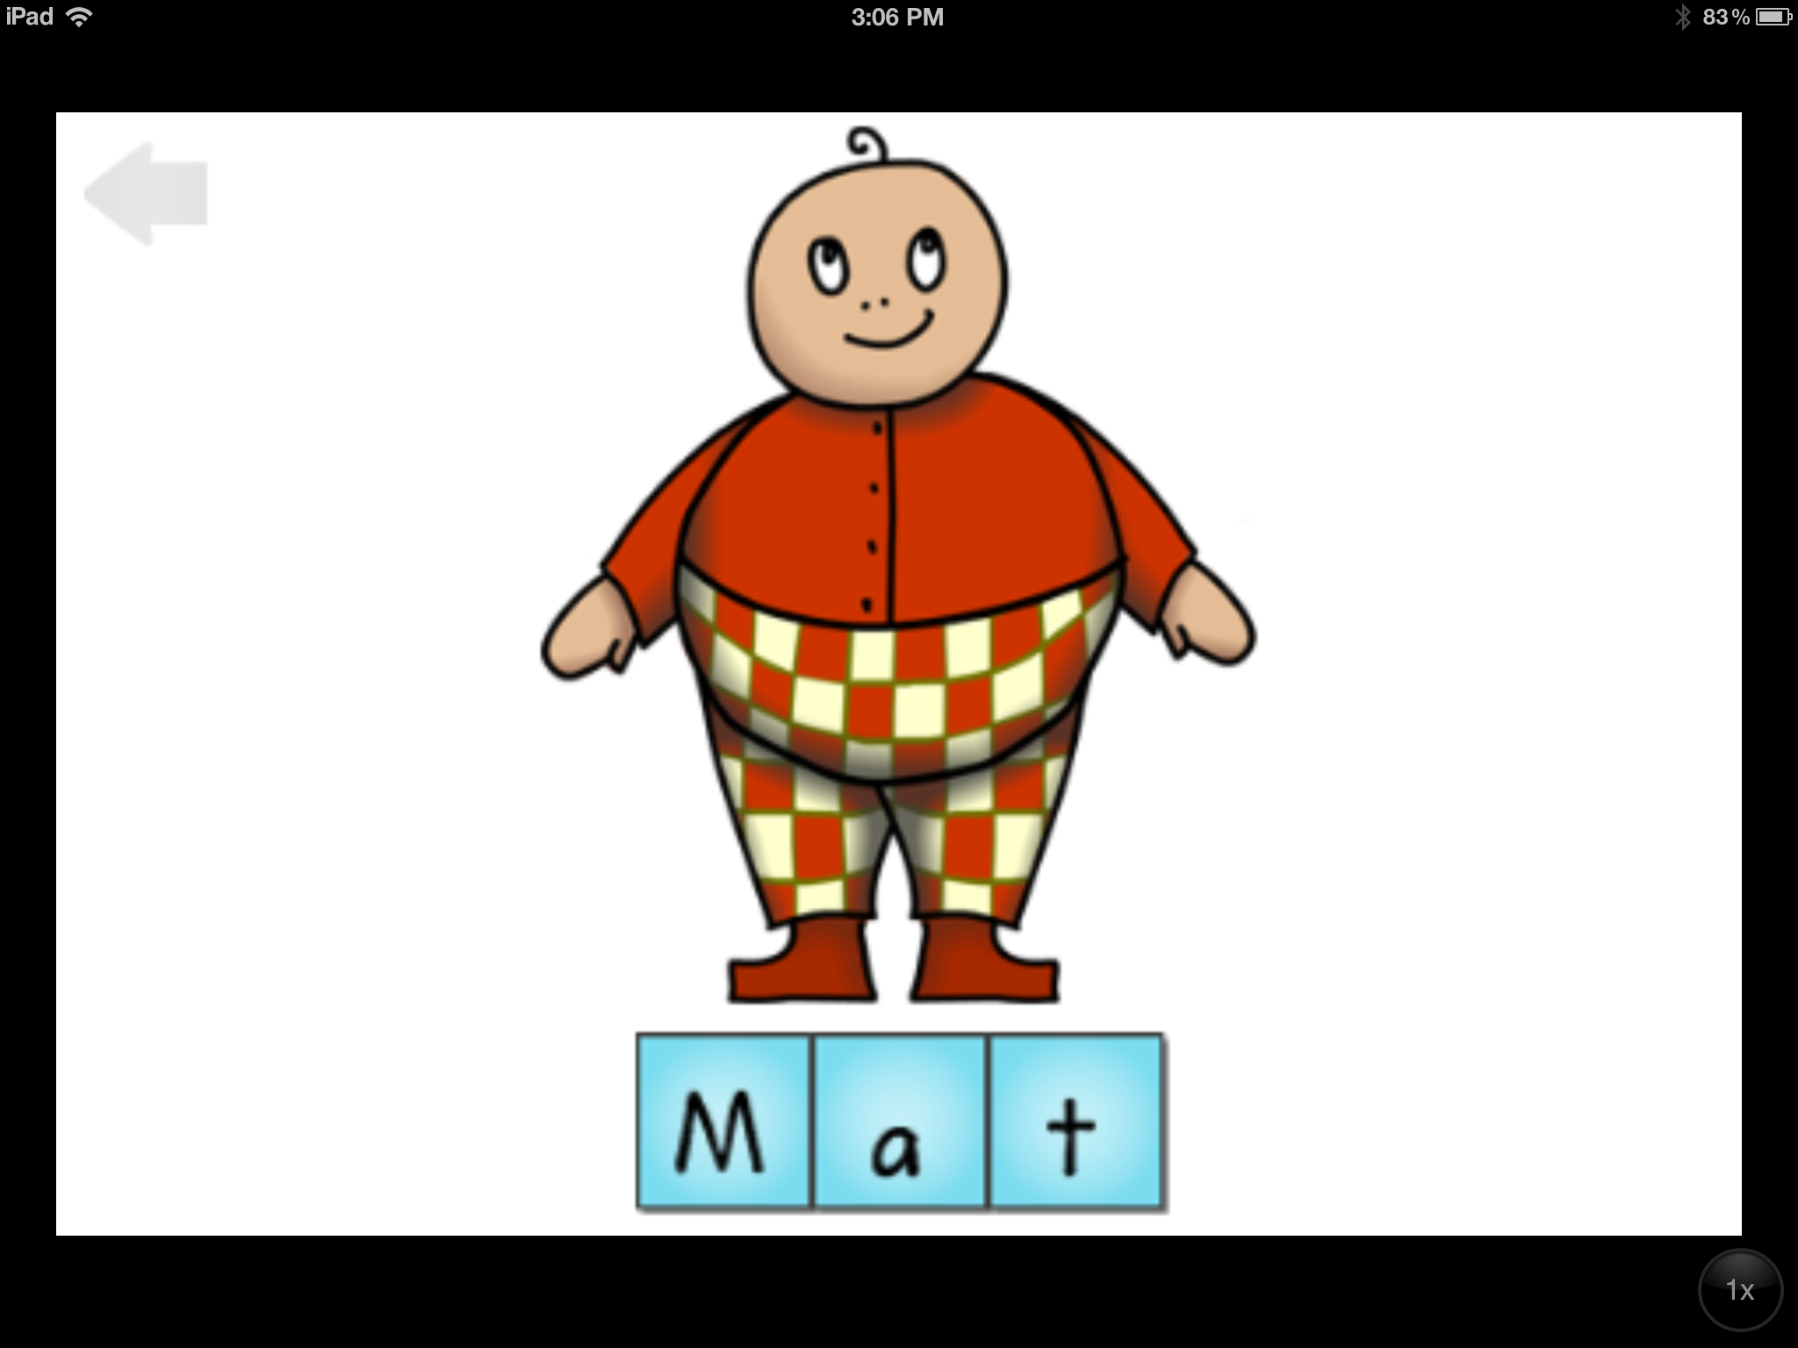
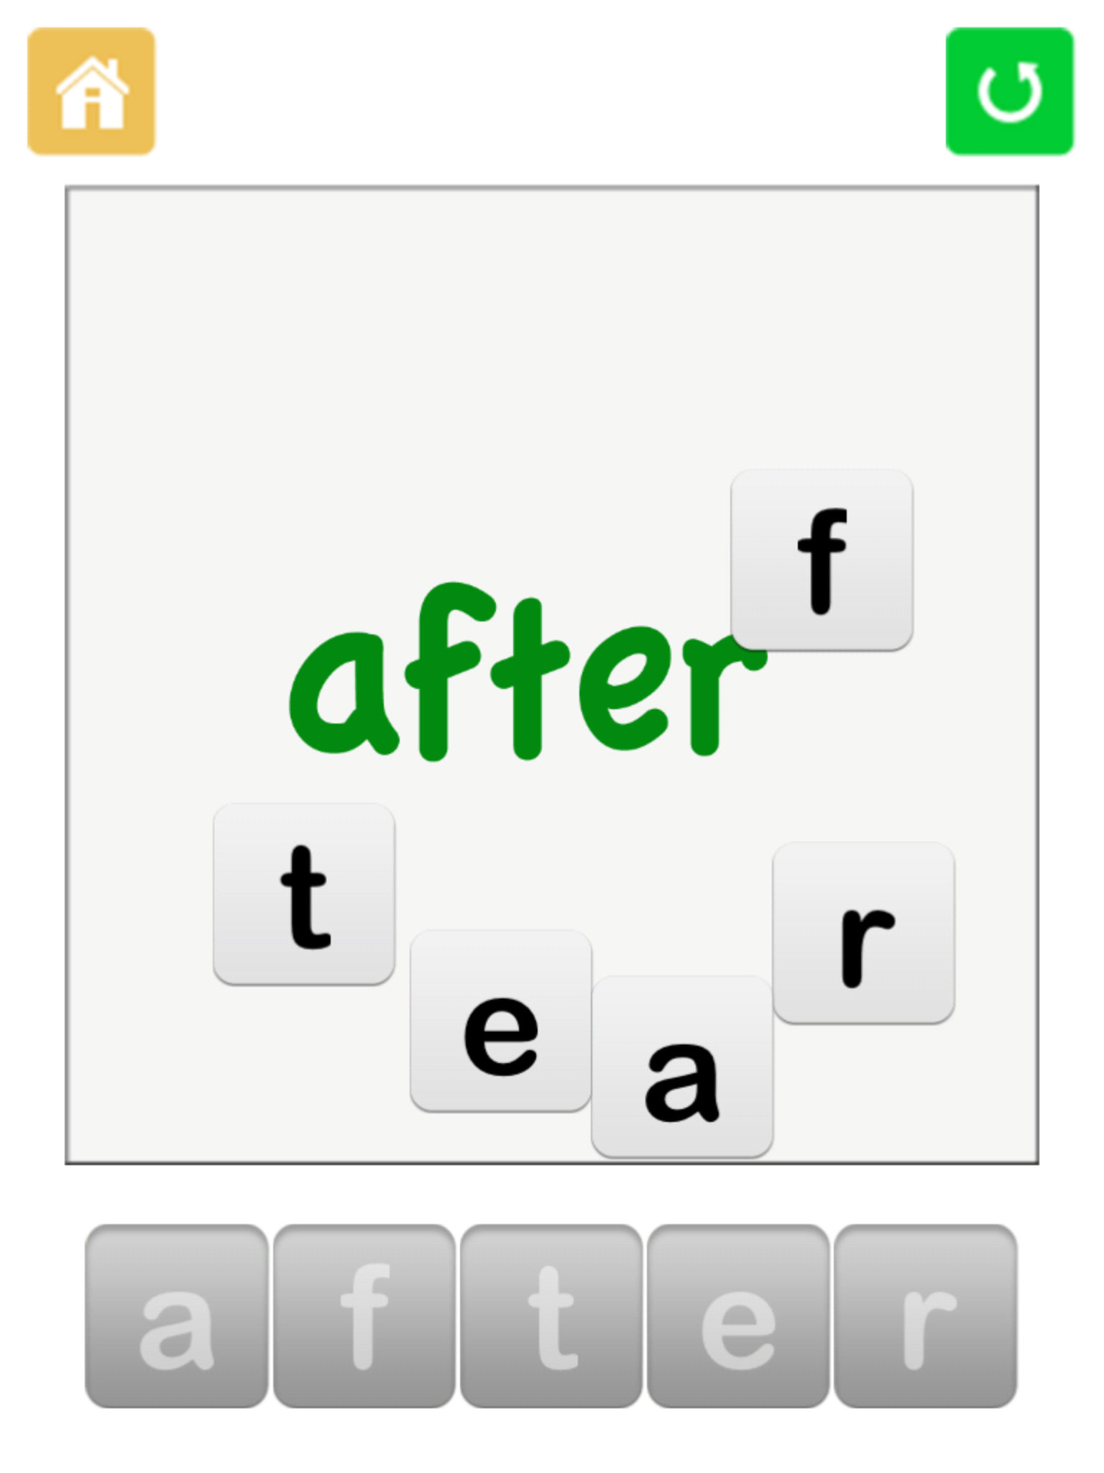
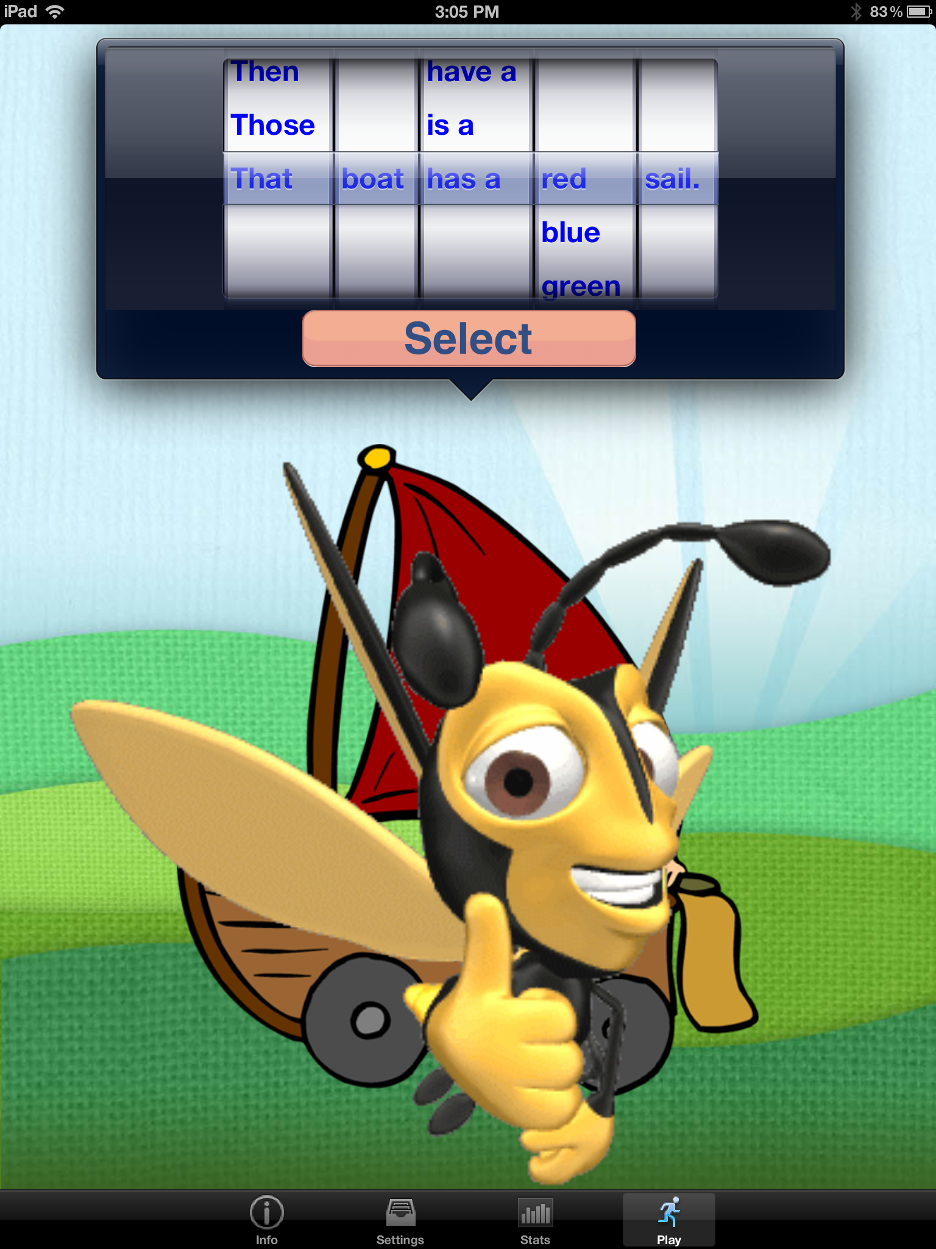
Apps

Slide 16
Suggested Apps
Little Speller
Bob Books
Starfall ABC’s
Lakeshore
Toontastic
Puppet pals HD
DTT Words
DTT Letters
PCS
Meet the Letters
See. Touch. Learn.
Sentence maker
Sight Words Sentence Builder
Scholastic Storia
Splingo
Sentence Builder
Sentence Magic
Choice Board Creator
RJ Cooper: Spell A Word
Point to Pics
Doodle Buddy
Do As Me
iWrite Words
Trace Right
Letter Quiz
Preschool Matching Games:
Rhyming Words
Super Duper
Autism Apps

Slide 17
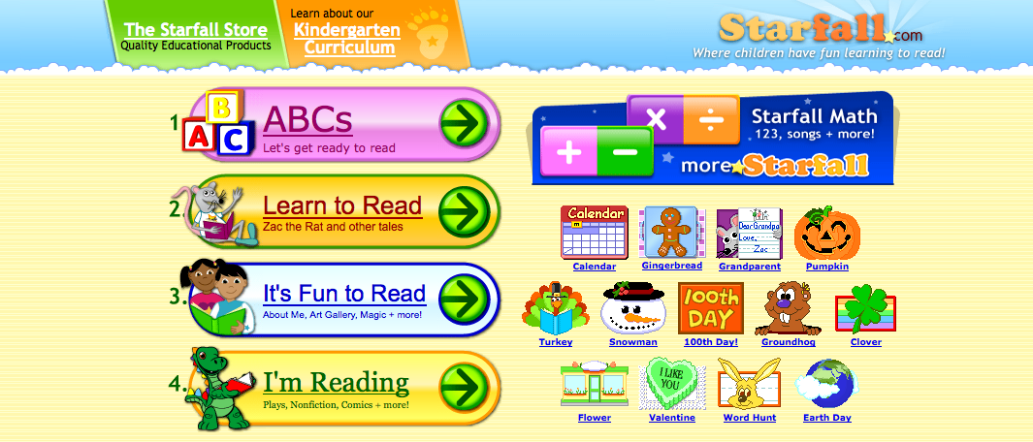
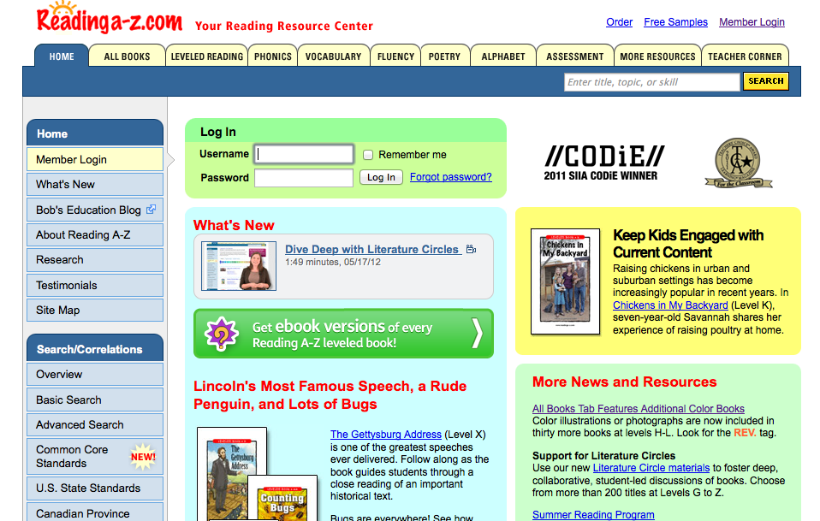
Computer

Slide 18
Computer

Slide 19
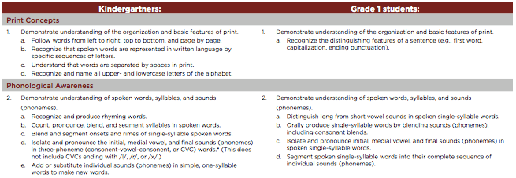
Common Core Standards: Foundational Reading Skills
http://www.corestandards.org/

Slide 20
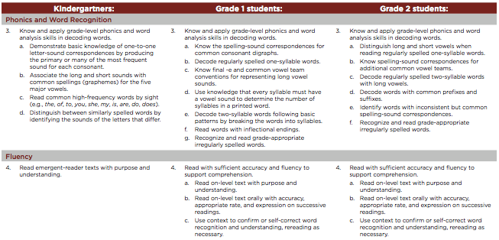
Common Core Standards: Foundational Reading Skills
http://www.corestandards.org/

Slide 21
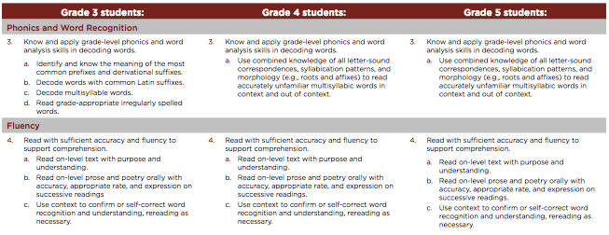
Common Core Standards: Foundational Reading Skills
http://www.corestandards.org/

