Slide 1
You, Too, Can Create an Attractive iBook
APS Technology Conference
December 4, 2012
Larada Horner-Miller
1

Slide 2
Objectives
Introduce the “How to” from Beginning to End
Highlight My Lessons I learned
2

Slide 3
Joe’s Non-Netbook
3

Slide 4
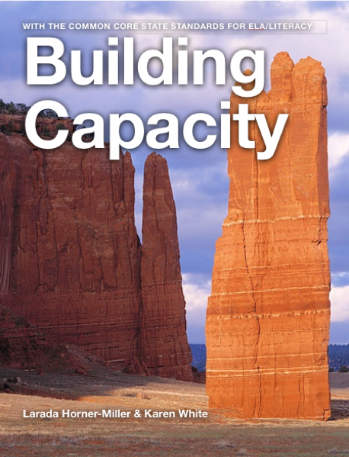
My iBook
Building Capacity with the Common Core State Standards for ELA/Literacy
By: Larada Horner-Miller
& Karen White
at the iBook Store
for
FREE

Slide 5
How to Build an iBook in iBooks Author
5

Slide 6
1. Create an Apple ID Account
2. Get the App
Go to Apple App Store
and Download
6

Slide 7
iBooks Author Template Elements
Book Title
Intro Media
Table of Contents
Glossary
Chapters and Sections
7

Slide 8
Template Chooser
Landscape with Portrait
Portrait Only
8

Slide 9
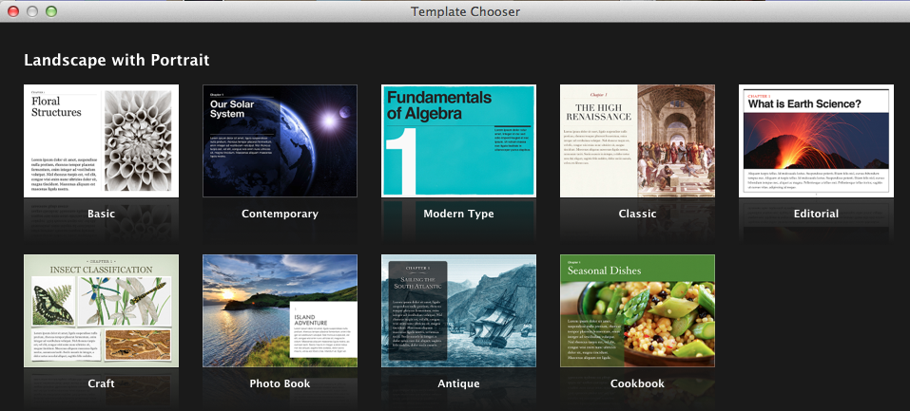
9

Slide 10
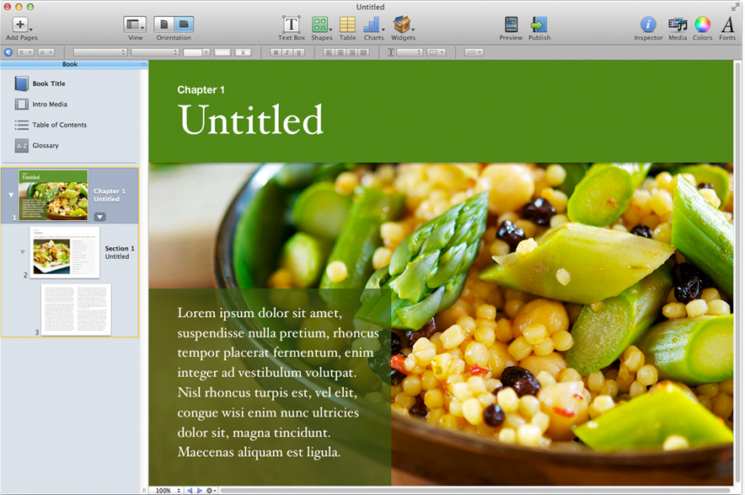
Sample Template
10

Slide 11
11

Slide 12
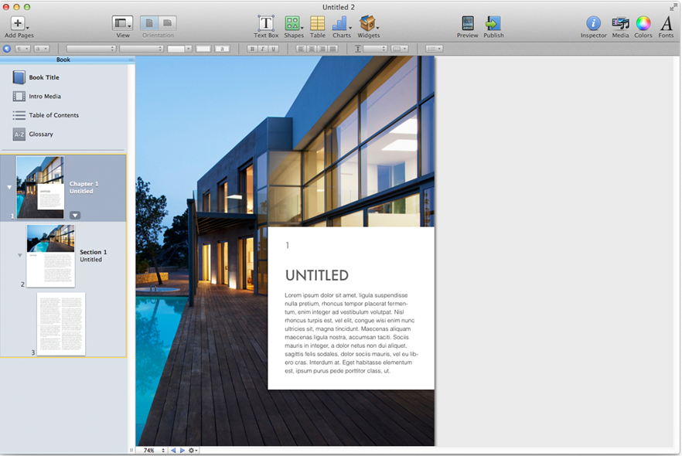
Sample Template
12

Slide 13
Let’s go to iBooks Author!
13
Notes:
Go to iBooks Author - Sample.iba

Slide 14
When you open iBooks Author
At the Template Chooser, choose one
Landscape with Portrait
Portrait Only
Use the Buttons Across the Top to Create
Don’t forget to use the Widgets
http://www.apple.com/ibooks-author/gallery.html
14

Slide 15
Widgets -- the Power!
15

Slide 16
Widgets Available
Interactive Gallery
Media
Chapter Review
Keynote
Interactive Image
3D Image
Scrolling Sidebar
Pop-over
HTML

Slide 17
Sample Workflow
17

Slide 18
1. Plan your book
2. Choose a template
3. Add your content
4. Create glossary entries
5. Preview your book
6. Share your book
Page 1 - Handout
18

Slide 19
How to Distribute
19

Slide 20
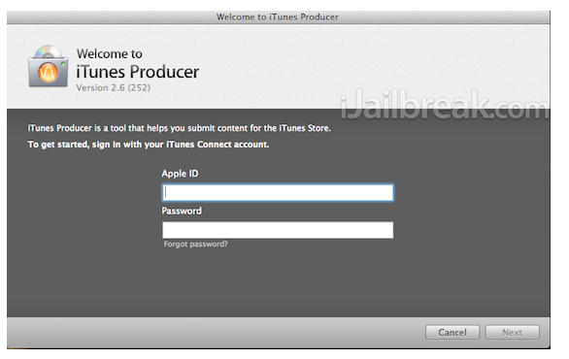
Distribute
.iba file
.pdf
text file
Publish
20

Slide 21
Extra Info - Lessons I learned!
21

Slide 22
Orientation format problem
Size limit - 2 GB --
SIZE, SIZE, SIZE MATTERS
Publishing turn-around time
22

Slide 23
Most teachers have resources that they have collected over the years. Here’s an opportunity to self-author a book and make your materials available to your students and the world in an attractive, easily accessible format!
23

